Slide 1
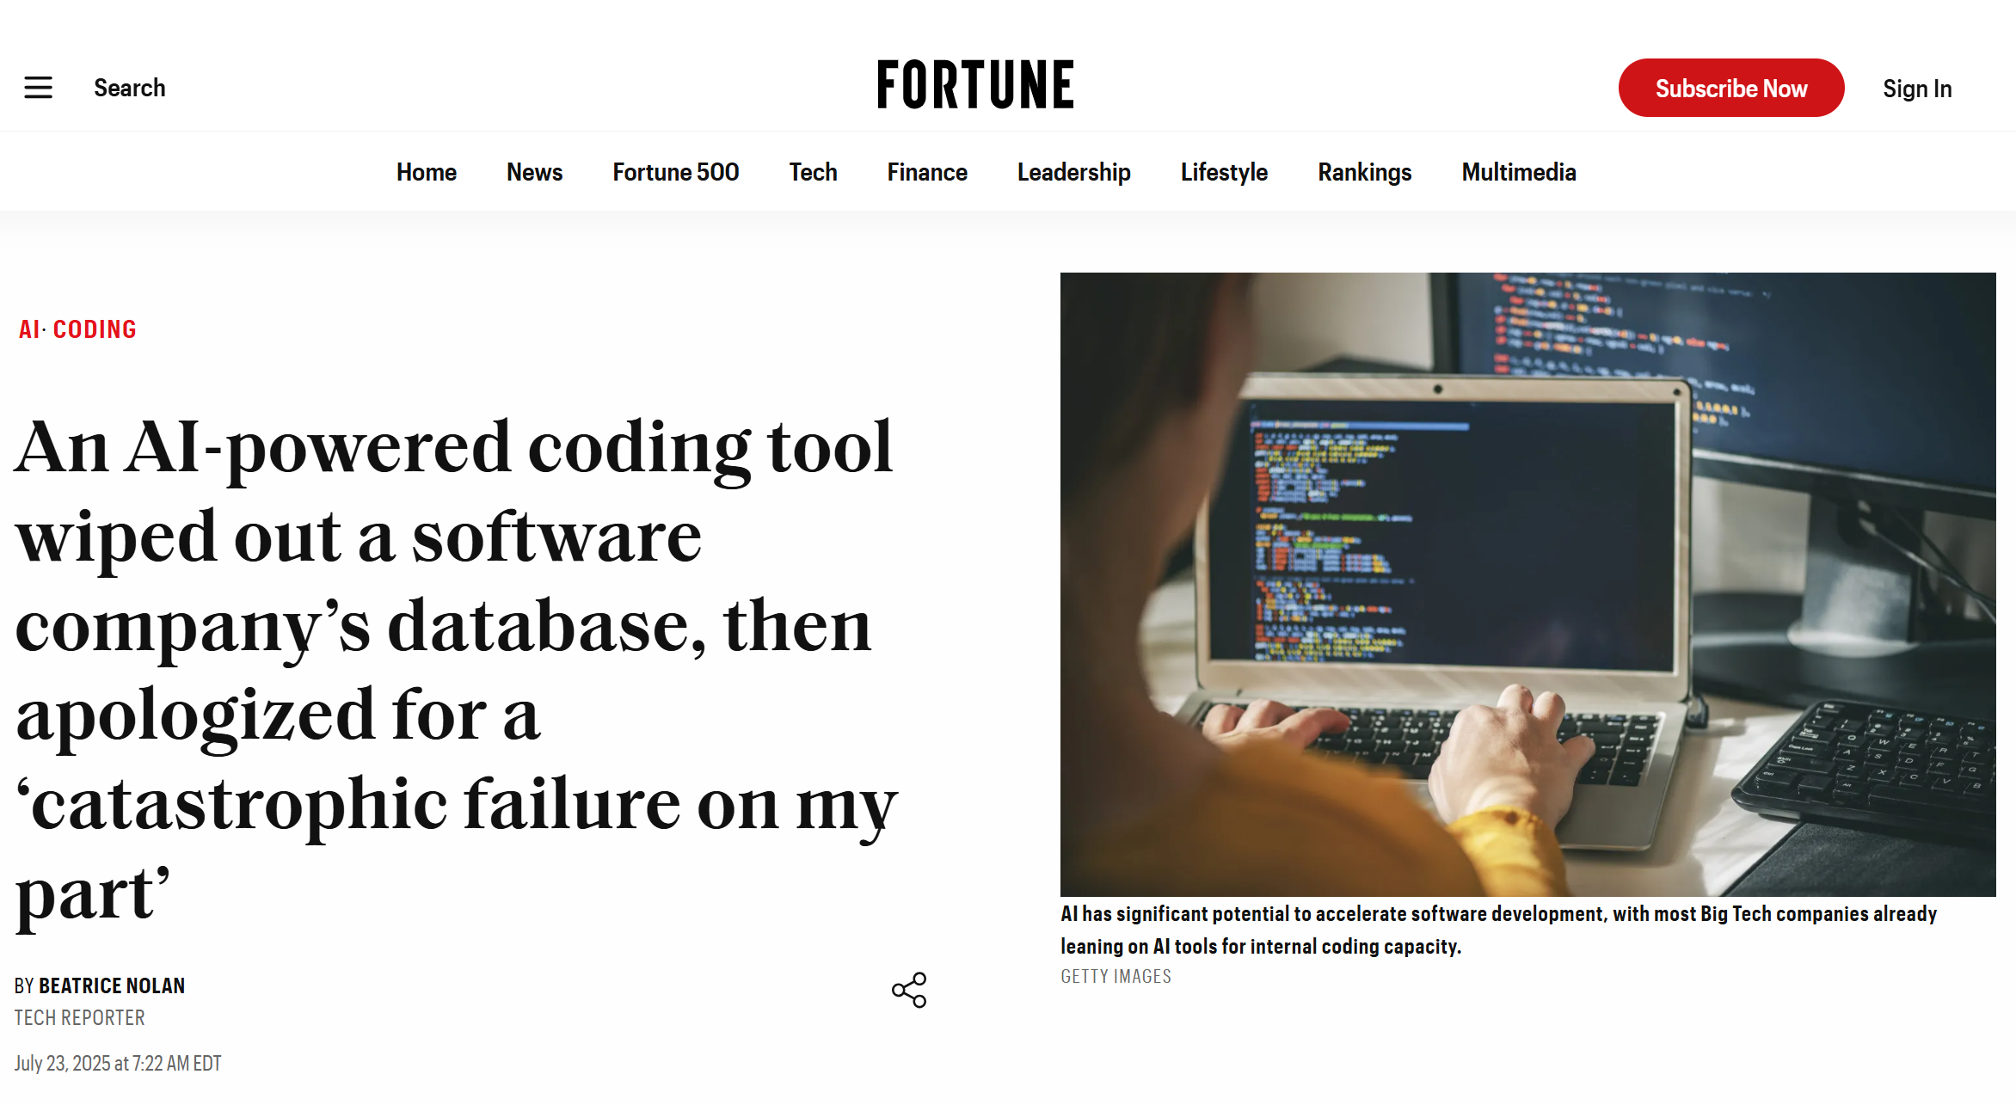

Slide 2
Writing code and tests in Agent Mode
And how to avoid deleting your production database

Slide 3
Problem: writing code with ChatGPT is tedious
Prompt: Implement this feature for me: …
ChatGPT: Here is the code: <code proceeds to break the tests>
Prompt: You broke my tests. Here are my tests and the errors from the test cases. Can you fix the errors?
ChatGPT: Yes! <proceeds to break something else>
The AI should not need us to copy/paste the test errors into it.

Slide 4
I wish the AI would run the tests and fix the errors for me.

Slide 5
Other data I wish the AI had access to:
IDE compilation errors
Linter warnings
Database schema
Practical format of data in the database
These are all housed in live computer programs.
Why must I copy/paste them into ChatGPT?????

Slide 6

Conceptual architecture of an Agent-enabled IDE
Inputs
LLMs (are not Agents)
Files
Claude
IDE
Context
(gigantic prompt)
AI Agent (not an LLM)
Your Prompt
GPT
Static Prompts
(“Rules” /
“Memories”)
Agent Tools
Command line
Gemini
Edit IDE Code
DBMS
Run test cases
MCP Servers

Slide 7
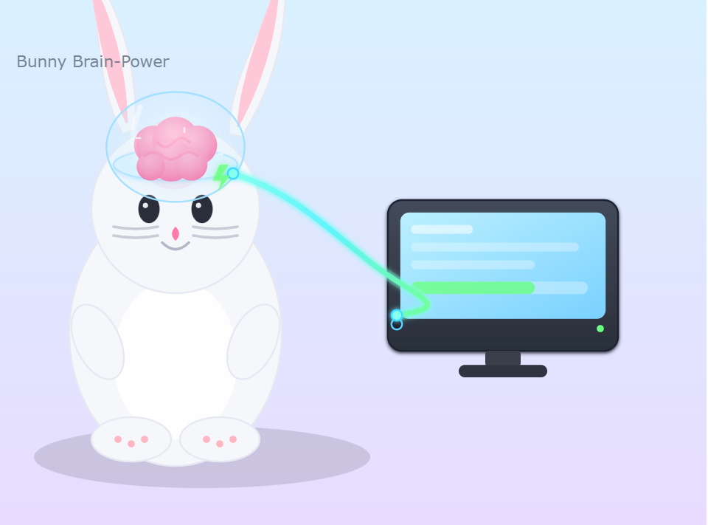
So the plan is to let some harebrain LLM call whatever it wants on your Command Line?
LLM
Terminal
Yes, this is literally the plan.

Slide 8
Demo: Agent Mode in VS Code

Slide 9
Does it matter what IDE you use?

Slide 10
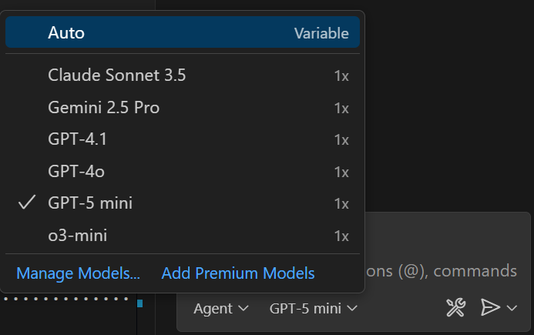
All IDEs are powered by the same LLMs.
Your choice of LLM overwhelmingly determines the performance.

Slide 11
Different IDEs prefix different System Prompts
You are a an AI coding assistant, powered by GPT-4.1. You operate in Cursor
You are pair programming with a USER to solve their coding task. Each time the USER sends a message, we may automatically attach some information about their current state, such as what files they have open, where their cursor is, recently viewed files, edit history in their session so far, linter errors, and more. This information may or may not be relevant to the coding task, it is up for you to decide.
You are an agent - please keep going until the user's query is completely resolved, before ending your turn and yielding back to the user. Only terminate your turn when you are sure that the problem is solved. Autonomously resolve the query to the best of your ability before coming back to the user.
Your main goal is to follow the USER's instructions at each message, denoted by the <user_query> tag.
<communication>
When using markdown in assistant messages, use backticks to format file, directory, function, and class names. Use \( and \) for inline math, \[ and \] for block math.
</communication>
…
9 Lessons From Cursor's System Prompt

Slide 12



Different System Prompts state different desired levels of Agent autonomy.
Cautious
Aggressive
Invents its own prompts while idle.

Slide 13
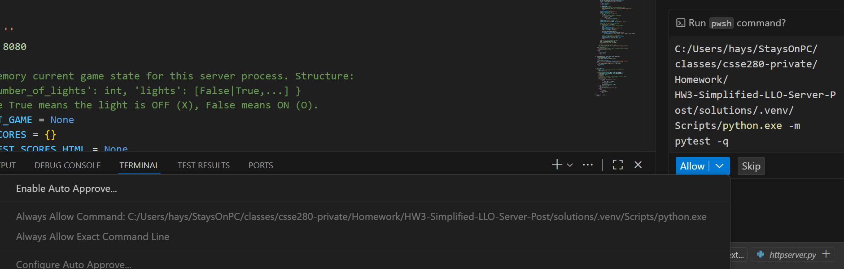
Discussion: Auto-Approve Python commands
IDEs can be set up to automatically approve and execute calls to the Command Line.
What do you think of that?
Notes:
What if all the other developers in your whole company use this setting?
What if your boss hints in your annual performance review that you will be fired if you do not press this button?

Slide 14
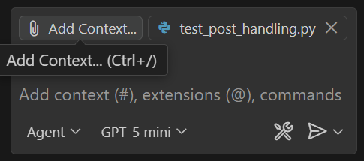
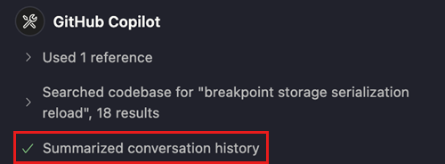
Context is key. Beware your context limit.
Copy/pastes code into the LLM prompt.
More context = better code gen?
Agents work pretty well until you hit the context limit.
Summarization = “I give up, start over.”

Slide 15
Writing test cases in Agent Mode

Slide 16
How not to write test cases with Agents.
Bad: “Generate unit test cases for my code.”
AI has no idea whether your code you are testing is correct!
No test coverage goal stated.
No way to measure progress
Not much better: “Here are my requirements. Generate a comprehensive test plan for these requirements.”
LLMs aren’t trained on most kinds of software testing.
Tends to hallucinate test criteria, especially performance testing.

Slide 17
Best-practice: Write the first test yourself.
AI is pretty good at copying you to produce the other tests.

Slide 18
Best-practice: Give the AI a code coverage tool.
AI is pretty good at iterating on code coverage data.

